Slide 1
2026 California Housing Outlook
Bridge Association of REALTORS®
August 13, 2026
Jordan G. Levine
SVP & Chief Economist
California Association of REALTORS®

Slide 2
Geopolitical Events?

Slide 3
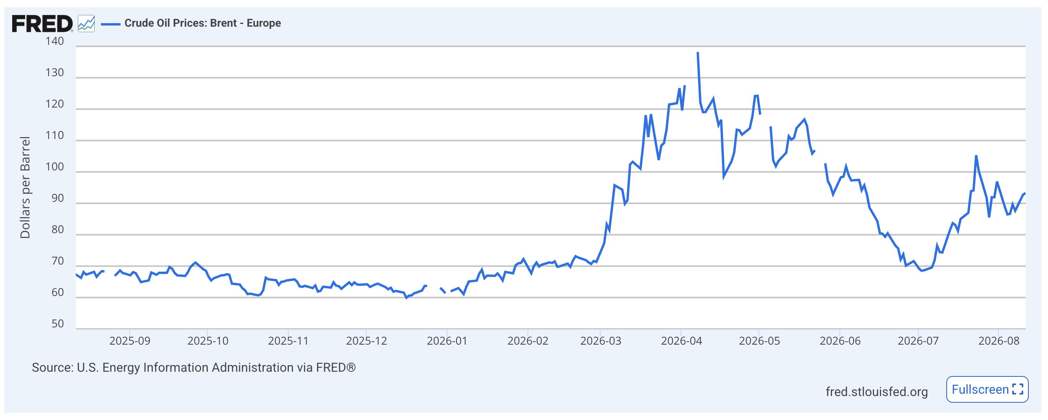

Slide 4
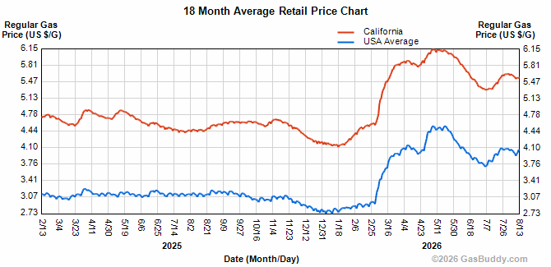

Slide 5
Energy prices also drive food prices

Slide 6
Inflation may ramp back up

Slide 7
Cut
Hike
~70%

Slide 10
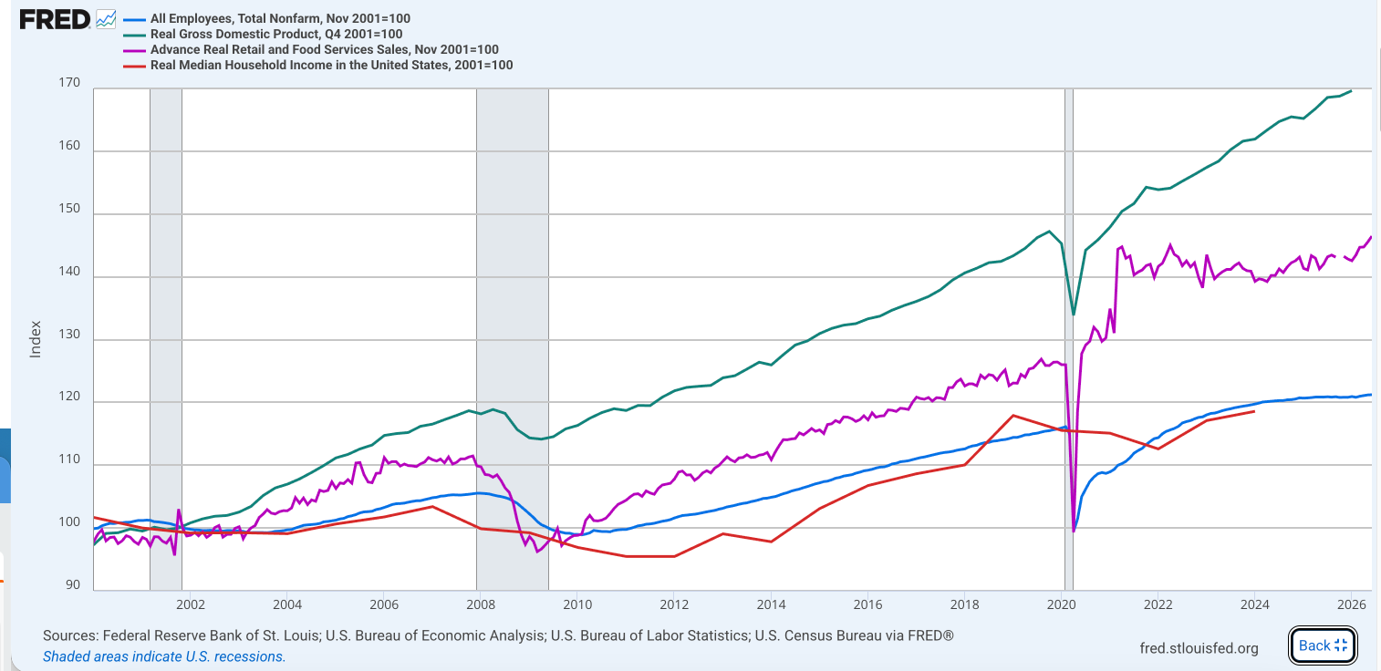

Slide 11
Artificial Intelligence

Slide 12
Investment in AI is driving economic growth
Source: Bureau of Economic Analysis, UCLA Anderson Forecast
Notes:
Source: https://finance.yahoo.com/economy/articles/heres-much-iran-war-costing-094501523.html

Slide 13
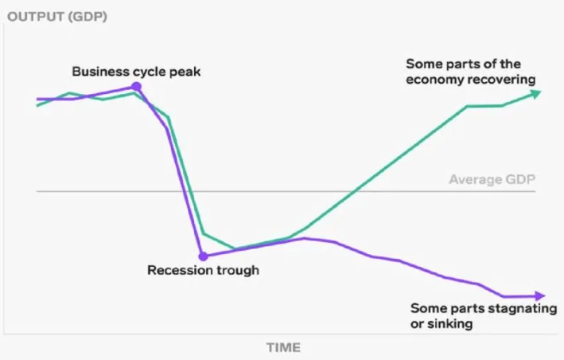
K-Shaped Economy
Top End doing well
Rest treading water

Slide 17
Which brings us to housing

Slide 22
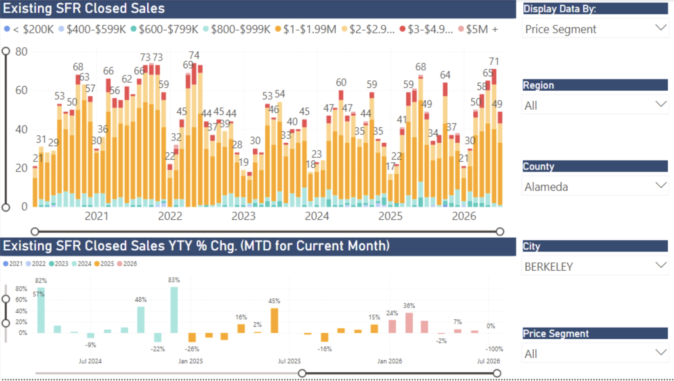

Slide 23
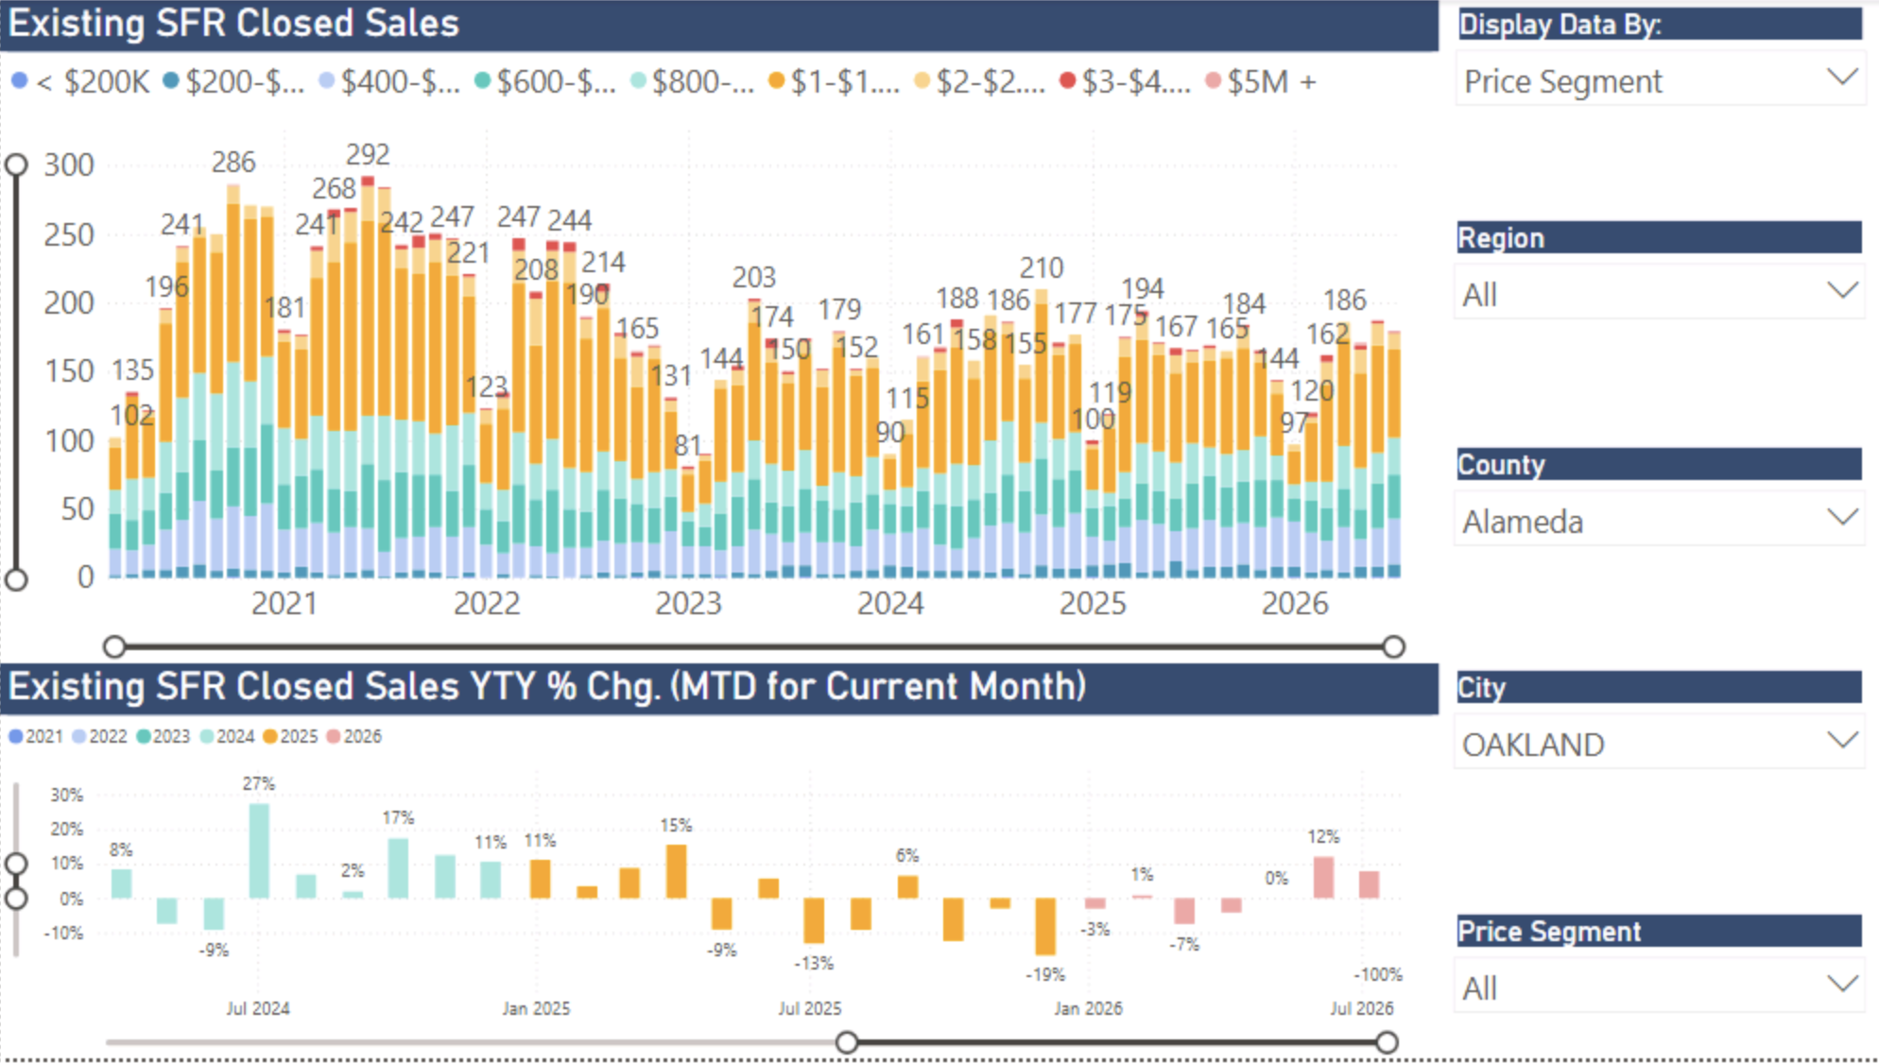

Slide 24
What about home prices?

Slide 25
California median home price near record high
SERIES: Median Price of Existing Single-Family Homes
SOURCE: CALIFORNIA ASSOCIATION OF REALTORS®

Slide 29
Insurance premiums will continue to climb in 2026
SOURCE: National Association of Insurance Commissioners, Cotality
SOURCE: Insurify, Quadrant
Notes:
Statewide average: Industry filings and regulatory data suggest average property insurance premiums in California will rise by about 7–10% in 2026. Some carriers have already secured significant increases effective into 2026:
Grange Insurance: Up to 40% for certain homeowners policies starting January 2026.
Wawanesa: Around 35% for many policyholders.
Stillwater: About 16% increase.
USAA filing: Seeking a 7.3% increase for 2026, impacting 350,000 customers. Rates could climb much higher for homes in high-risk wildfire zones (e.g., Malibu).
State Farm scenario: If its additional 11% hike request is approved, combined with prior increases, the average policyholder would pay 55% more in 2026 than in 2023, with some high-risk ZIP codes seeing premiums nearly double.

Slide 32
The benefits of homeownership are well documented

Slide 33
Looking ahead?

Slide 34
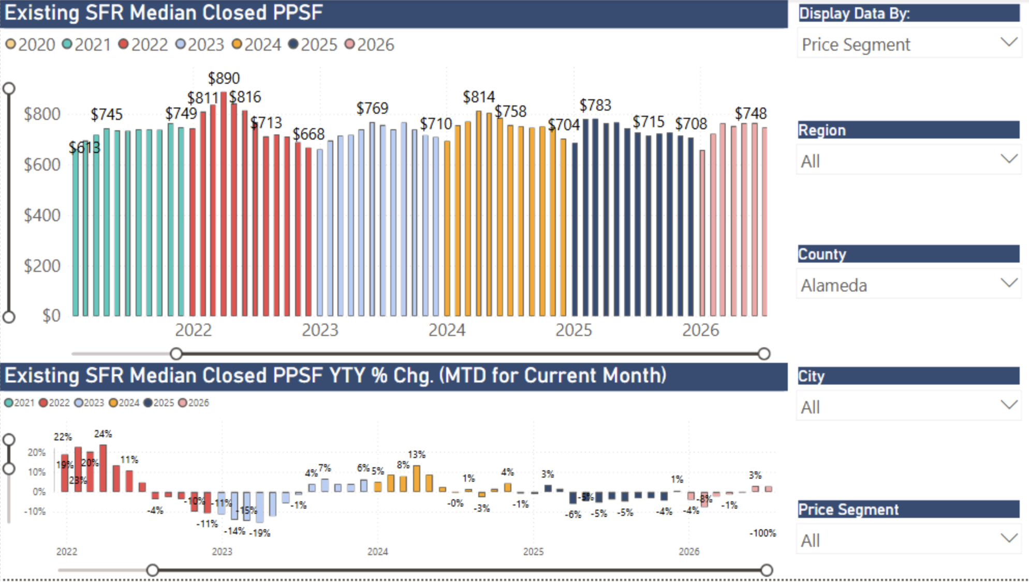

Slide 35
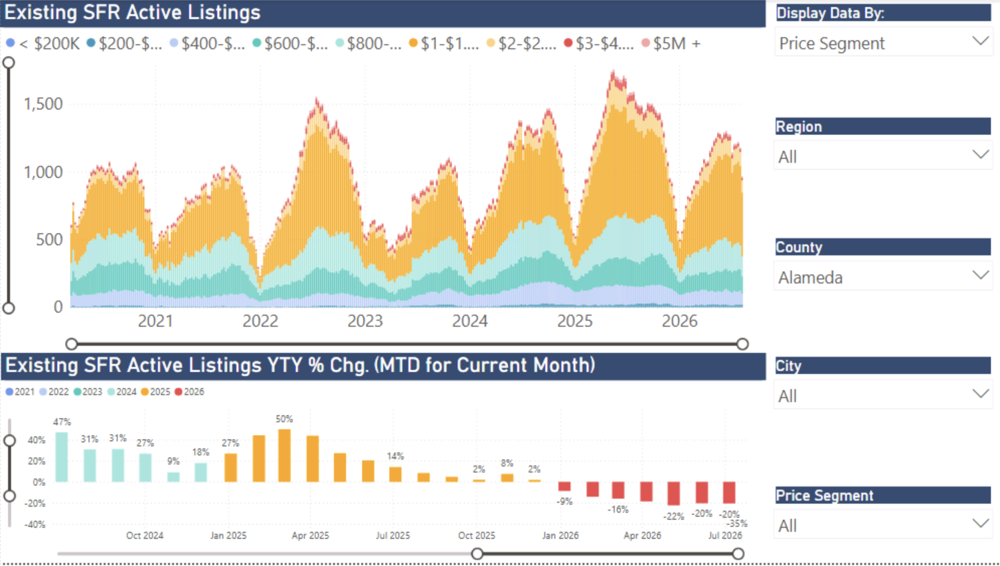

Slide 36
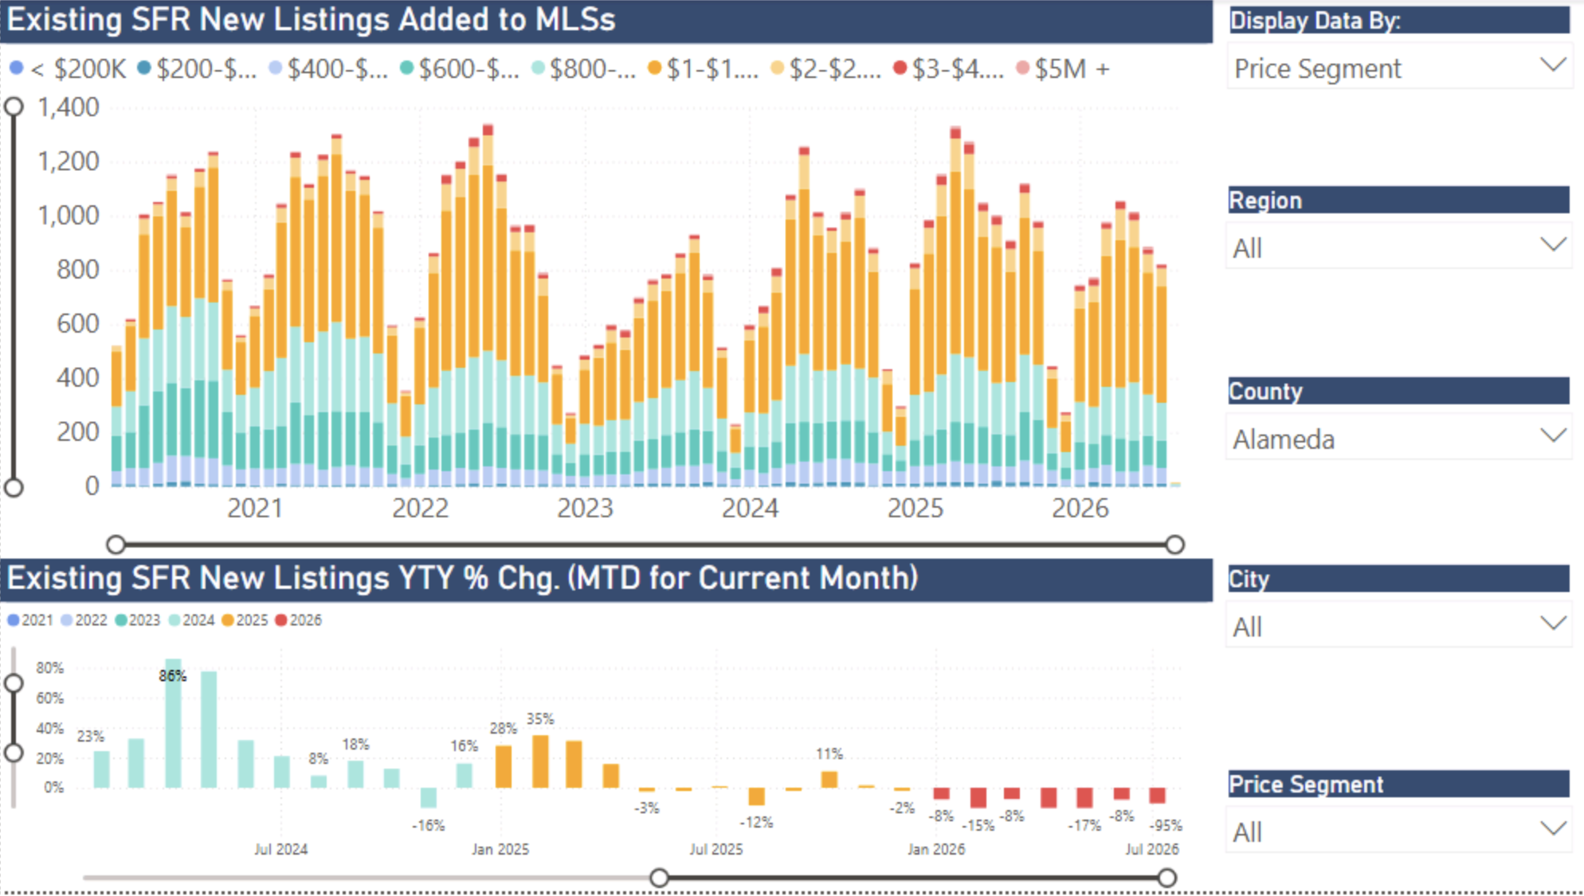

Slide 37
61% Still
Below 4%

Slide 38
Sellers’ housing tenure all-time high
  Homeowners holding onto their properties longer before selling because:
  Low rate on current mortgage
  Low property taxes
  Capital gains hit
  Where can I afford to go?
  Remodel and stay
SERIES: 2025 Housing Market Survey
SOURCE: CALIFORNIA ASSOCIATION OF REALTORS®

Slide 39
Manage expectations!

Slide 42
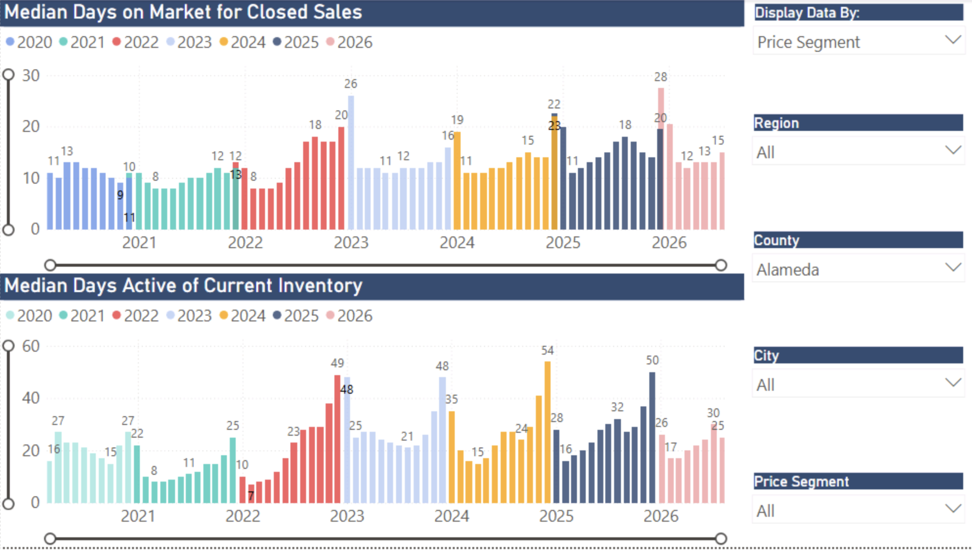

Slide 43
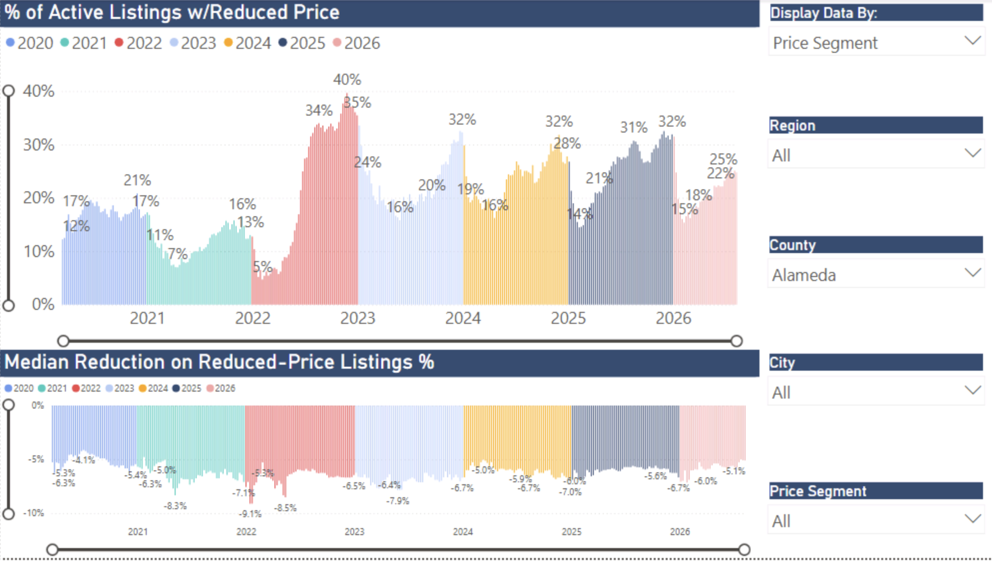

Slide 44
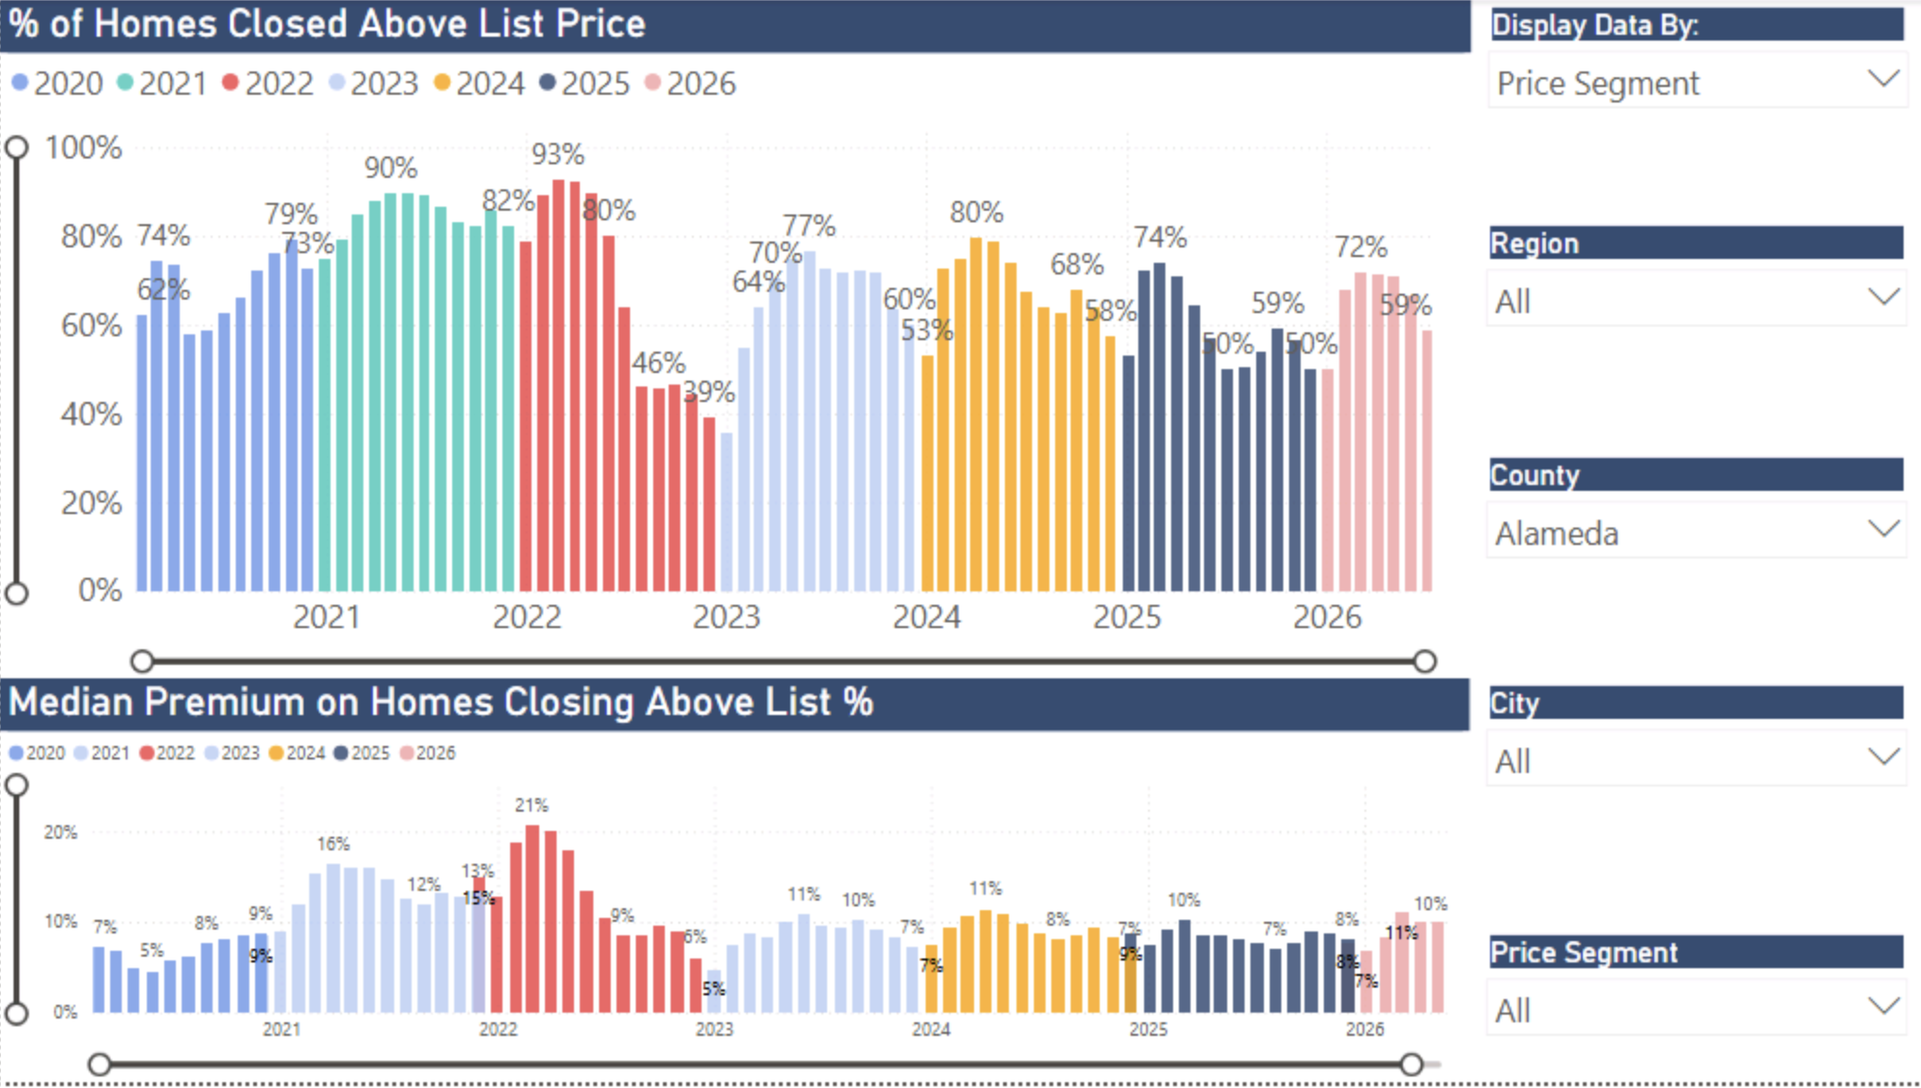

Slide 45
Putting It All Together

Slide 46
U.S. economic outlook
 | 2016 | 2017 | 2018 | 2019 | 2020 | 2021 | 2022 | 2023 | 2024 | 2025 | 2026p | 2027f
US GDP | 1.8% | 2.5% | 3.0% | 2.5% | -2.2% | 5.8% | 1.9% | 2.9% | 2.8% | 2.1% | 1.7% | 2.0%
Nonfarm Job Growth | 1.8% | 1.6% | 1.6% | 1.3% | -5.8% | 2.9% | 4.3% | 2.2% | 1.2% | 0.6% | 0.4% | 0.4%
Unemployment | 4.9% | 4.4% | 3.9% | 3.7% | 8.1% | 5.4% | 3.6% | 3.6% | 4.0% | 4.3% | 4.6% | 4.5%
CPI | 1.3% | 2.1% | 2.4% | 1.8% | 1.2% | 4.7% | 8.0% | 4.1% | 3.0% | 2.7% | 3.4% | 2.5%
Real Disposable Income, % Change | 1.9% | 3.1% | 3.6% | 3.1% | 6.4% | 3.1% | -5.9% | 5.1% | 2.9% | 1.7% | 1.5% | 2.7%

Slide 47
California housing market outlook
 | 2016 | 2017 | 2018 | 2019 | 2020 | 2021 | 2022 | 2023 | 2024 | 2025 | 2026p
SFH Resales (000s) | 417.7 | 424.9 | 402.6 | 398.0 | 411.9 | 444.6 | 339.8 | 257.7 | 269.2 | 271.6 | 277.0
% Change | 2.0% | 1.7% | -5.2% | -1.2% | 3.5% | 7.9% | -23.6% | -24.2% | 4.4% | 0.9% | 2.0%
Median Price ($000s) | $502.3 | $537.9 | $569.5 | $592.4 | $659.4 | $784.8 | $819.4 | $814.3 | $865.6 | $875.6 | $905.8
% Change | 5.4% | 7.1% | 5.9% | 4.0% | 11.3% | 19.0% | 4.4% | -0.6% | 6.3% | 1.2% | 3.5%
Housing Affordability Index | 31% | 29% | 28% | 31% | 32% | 26% | 19% | 17% | 18% | 19% | 20%
30-Yr FRM | 3.6% | 4.0% | 4.5% | 3.9% | 3.1% | 3.0% | 5.3% | 6.8% | 6.7% | 6.6% | 6.2%

Slide 48
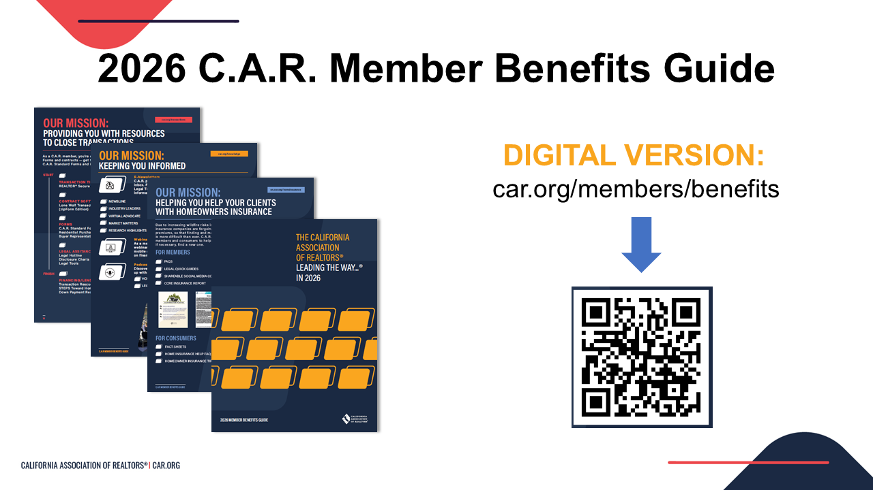
Notes:
Every year, C.A.R. puts out a Member Benefits Guide to help you keep track of your member benefits – all 152 of them.
This is a great resource to see everything that C.A.R. has to offer and the full value of your membership in the association
You can find the digital pdf of the guide by scanning the QR code on the screen.

Slide 49

Share your feedback on today's presentation and how C.A.R. can better serve you!

Slide 50
Thank You!!

